Slide 1
Safeguarding Children’s Guide
2025/2026

Slide 2
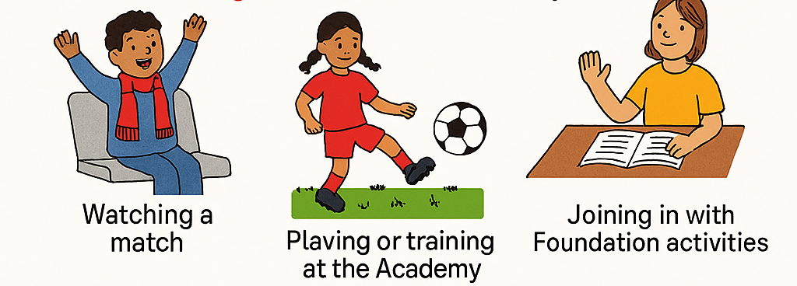
Safe at LFC – What is Safeguarding?
At Liverpool FC, we want all children and young people to feel happy, safe, and supported.
Safeguarding means keeping you safe and happy. It’s about making sure you are protected from harm, treated with respect, and have people you can trust and talk to if something worries you. You have the right to feel safe whether you're at home, at school, out with friends, or taking part in anything at LFC. That could be when you're:
Everyone at LFC has a responsibility to help keep you safe. That means we always put your wellbeing first and will listen if you ever feel worried or unsure about something.
If something doesn’t feel right, it’s always okay to speak up. There are people here who care and want to help.

Slide 3


What is abuse?
Abuse is when someone does something that can hurt you or make you feel unsafe.
It can happen anywhere at home, at school, at football, or even online.
If this happens, tell someone you trust straight away. We are here to help keep you safe.
There are different types of abuse;
PHYSICAL ABUSE: When someone is physically hurting you. Things like: – Hitting, smacking, and slapping, scalding, or burning you, spitting or throwing things at you, shaking, or suffocating you.
SEXUAL ABUSE: This is when someone touches you in a way that feels wrong, saying things that make you feel uncomfortable, making you watch or look at things that make you feel uncomfortable.
EMOTIONAL ABUSE: This is when a person makes you feel bad on purpose. They might ignore you or make you feel worthless, put you down, call you names and make fun of you.
If you or another child might be experiencing the above things, then you should try and tell an adult.

Slide 4
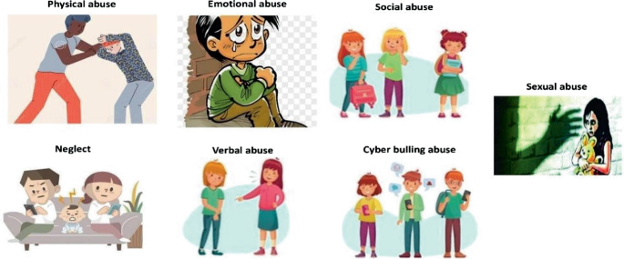
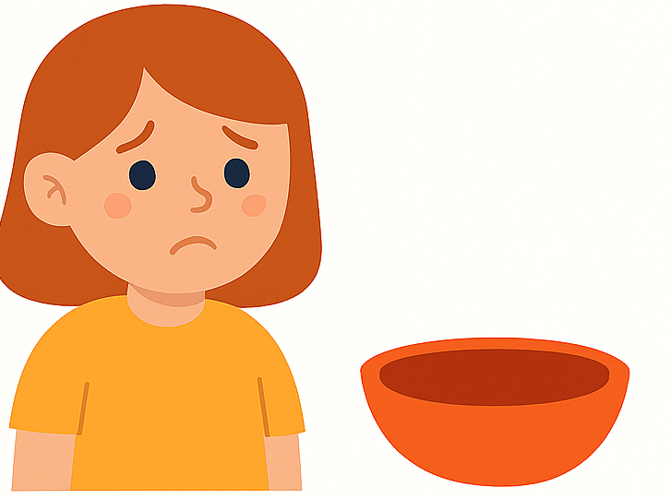
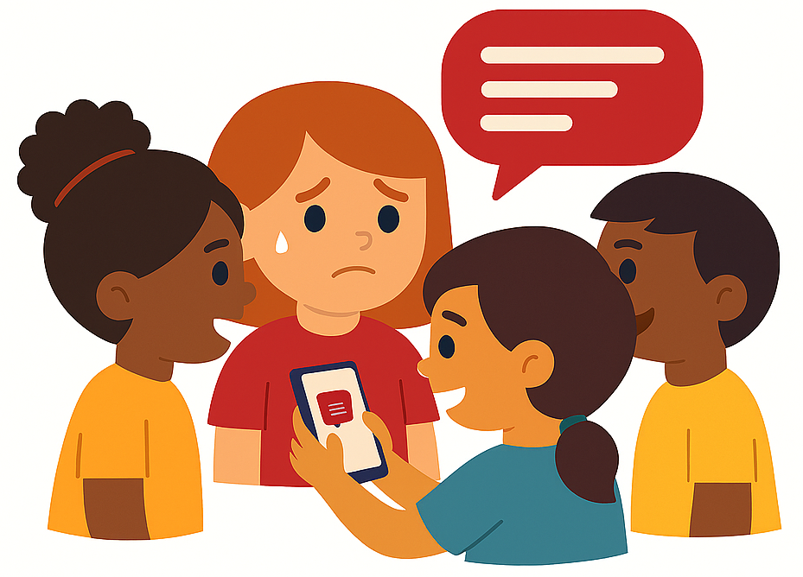
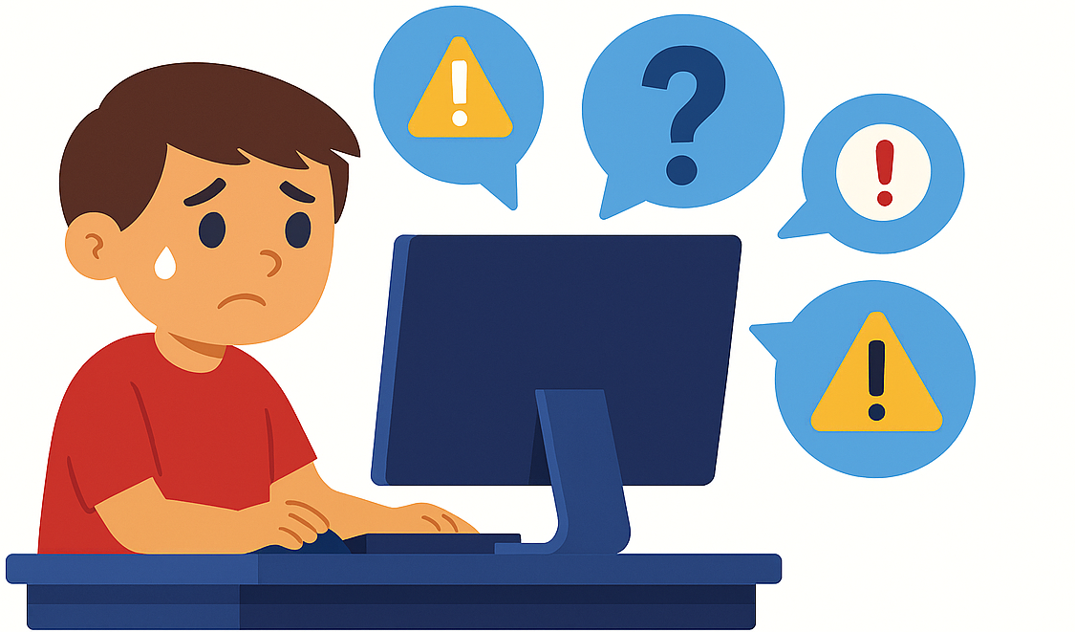
What is abuse?
Abuse is when someone does something that can hurt you or make you feel unsafe.
It can happen anywhere at home, at school, at football, or even online.
If this happens, tell someone you trust straight away. We are here to help keep you safe.
There are different types of abuse;
BULLYING: Is when someone is intentionally saying or doing things to upset you. This may be hurtful comments, being unfriendly, sending hurtful messages online, pushing, hitting or kicking or spreading rumours.
NEGLECT: This is when the adult looking after you, may not look after you properly, and you may not have the things you really need to be well. Things like: Food, clean clothes, medicine. It also includes things like protection from harm and dangerous people.
RADICALISATION: Where people try to encourage you to support their views and to support terrorist groups and activities. You may be asked to send messages that incite violence, or support terrorism.
If you or another child might be experiencing the above things, then you should try and tell an adult.

Slide 5
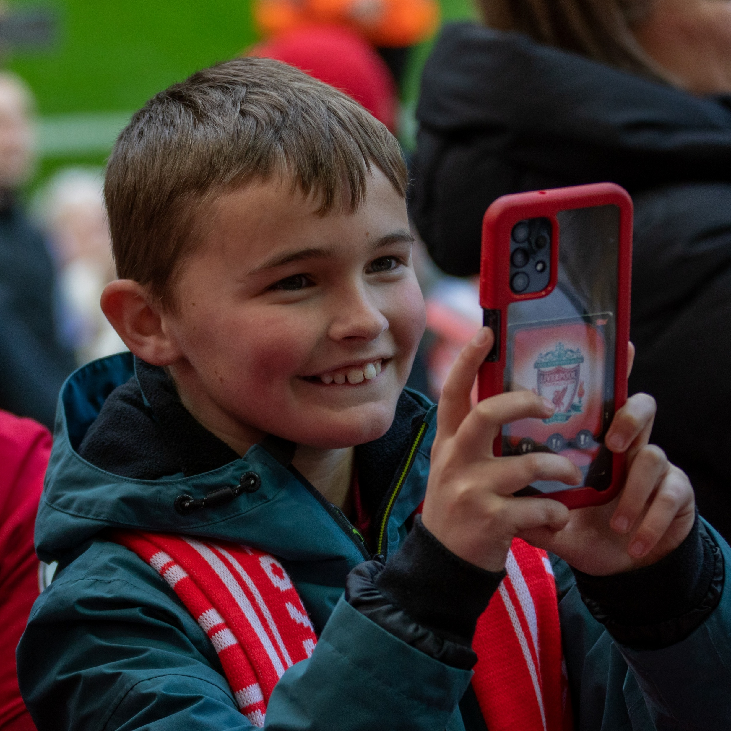
Who to speak to & what happens
Telling Someone. It’s Okay
If somebody has hurt, upset or made you or your friends feel unsafe, try to tell somebody. You don’t have to explain everything perfectly. Just say what you can. The most important thing is telling someone.
Who to Tell
Choose an adult you trust, someone who makes you feel safe and listens to you.
You can:
Talk to them
Write it down if that feels easier
They might ask questions to understand better. That’s because they want to help, not because they don’t believe you.
What Happens Next
The adult may need to tell other people to help keep you safe. They should explain who they will tell and why. They cannot keep secrets as they need to try and keep you safe.

Slide 6
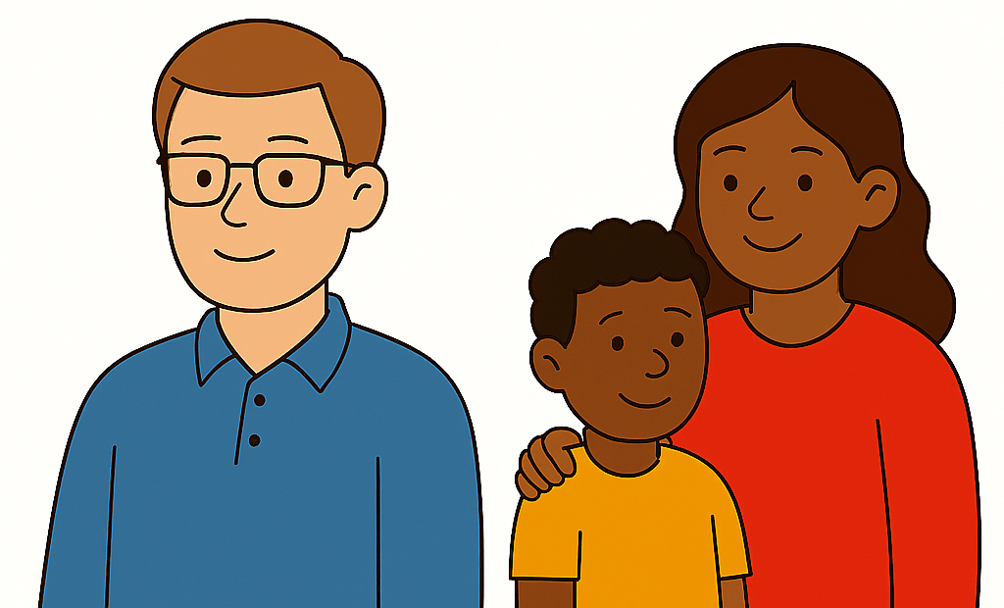

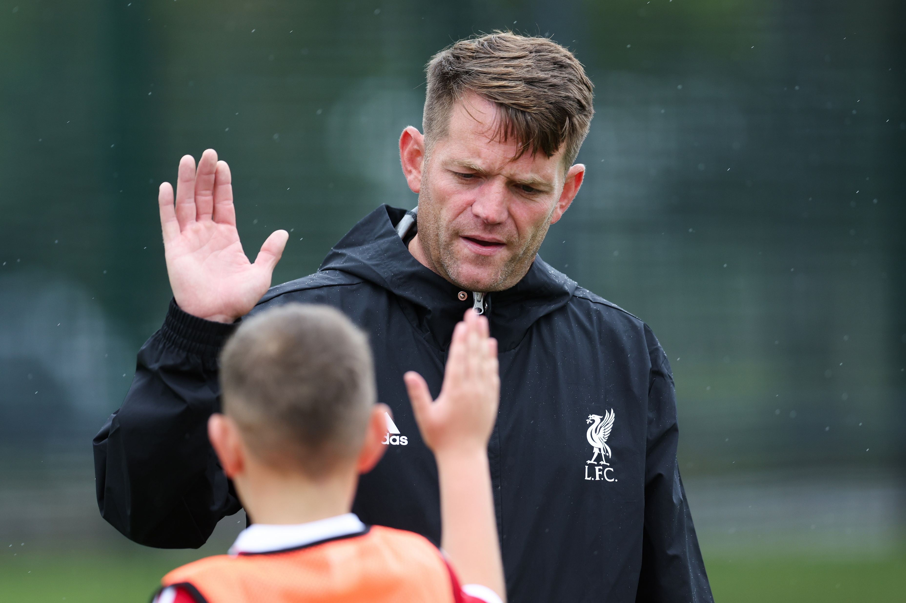
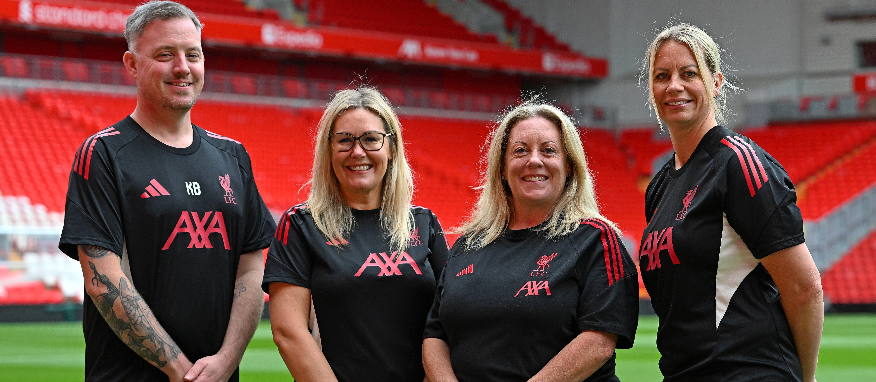



What to do if you are worried
Tell someone you trust (teacher, family member, friend)
Speak to a coach or staff member
Contact the LFC Safeguarding Team
Call Childline 0800 1111 if you need more help
Contact the NSPCC Helpline – 0800 1111
Contact https://www.ceop.police.uk/Safety-Centre/ if you are worried about online communication
You can report a concern anonymously via the website and clicking this link - https://www.liverpoolfc.com/info/report-safeguarding-concern

Slide 7
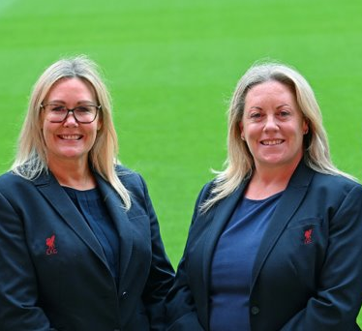
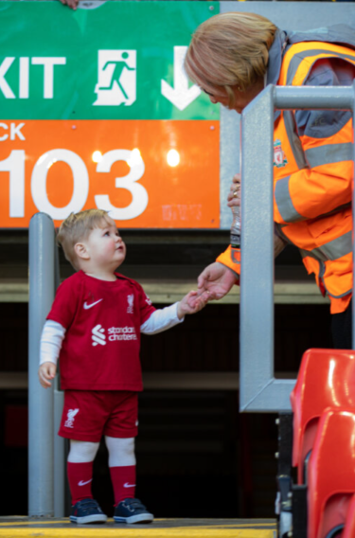
Who to talk to at LFC?
We have a dedicated Safeguarding team at Liverpool Football Club who you could reach out to directly.
You will find the LFC Safeguarding team in different areas of the club;
VICKY BUCKLEY-SMYTH
LFC Women DSL
LFCW Pro Game Academy Designated Safeguarding Lead
KIERAN BAILLIE
LFC Academy & AXA Designated Safeguarding Lead
NICOLA FRYER
LFC Director of Safeguarding
Nicola.fryer@liverpoolfc.com
LORNA DUCKWORTH
LFC Deputy Director of Safeguarding
LFC Foundation and
Anfield Designated Safeguarding Lead
Lorna.duckworth@liverpoolfc.com

Slide 8


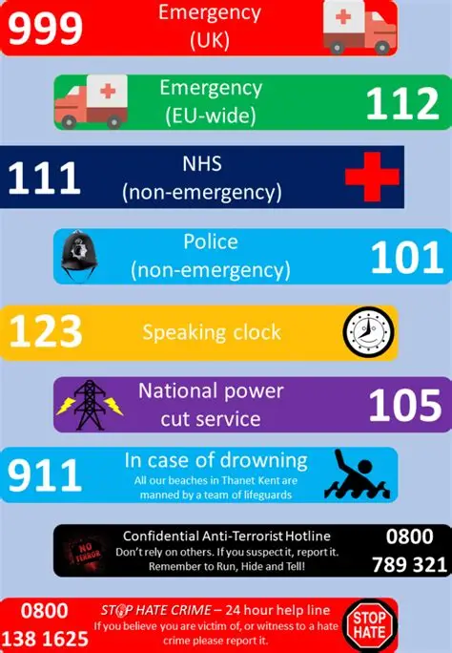


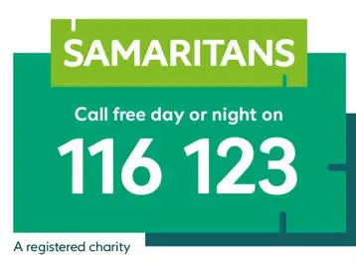

Contact information for people who can help
Hub of Hope national mental health database, bringing help and support together in one place, with a focus on mental health.
Hub of Hope is for everyone and anyone. We all have mental health, so we all need to know the routes to support. The Hub of Hope is not restricted by age or gender.
The hub of hope is available to anybody at hubofhope.co.uk and is a free, downloadable app on iOS and Android devices. Once you have downloaded the app, the user can filter by category of service and postcode.

Slide 9
Contact information for people who can help
Hub of Hope national mental health database, bringing help and support together in one place, with a focus on mental health.
Hub of Hope is for everyone and anyone. We all have mental health, so we all need to know the routes to support. The Hub of Hope is not restricted by age or gender.
The hub of hope is available to anybody at hubofhope.co.uk and is a free, downloadable app on iOS and Android devices. Once you have downloaded the app, the user can filter by category of service and postcode.

