Slide 1
Safeguarding Guide
Adult’s Version
2025/2026

Slide 2

Contents
Introduction
Safe at LFC – What is Safeguarding Adults?
What is Abuse?
Types of Abuse.
What to do if you are worried
Who to talk to at LFC
Useful Contacts

Slide 3
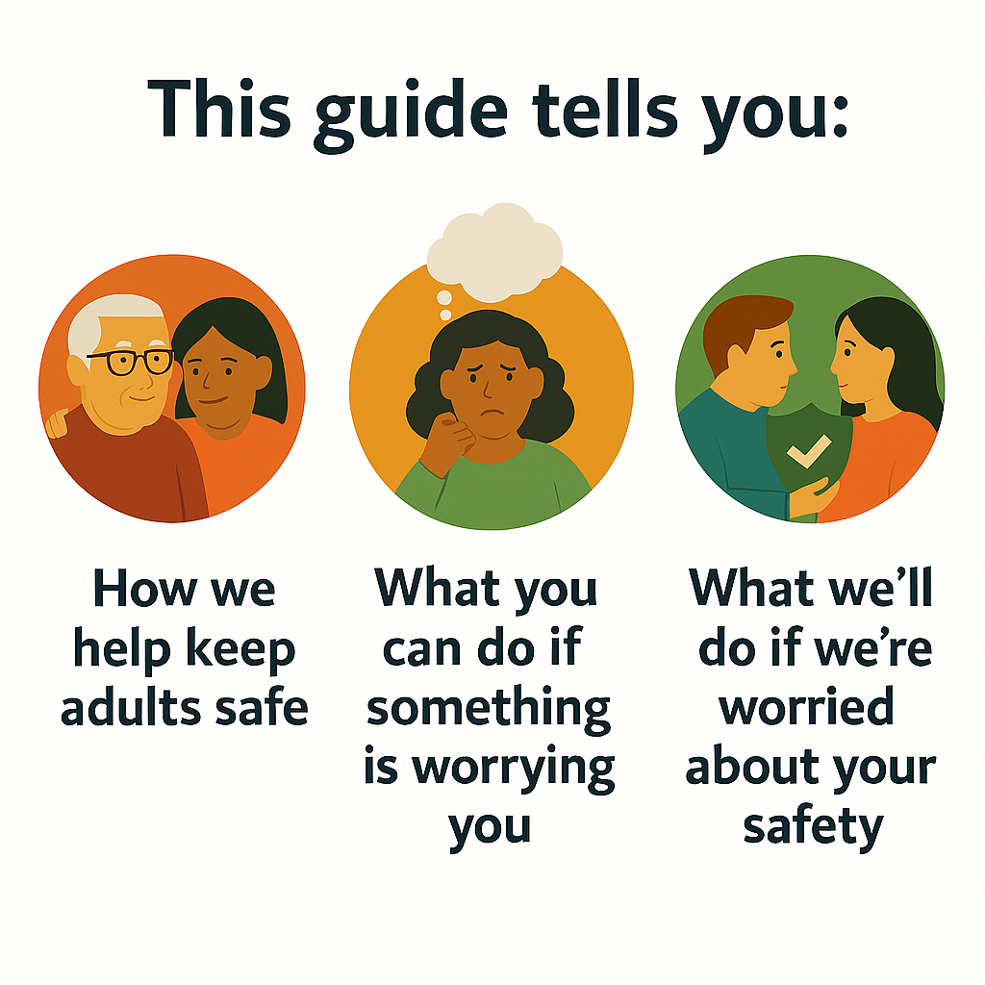
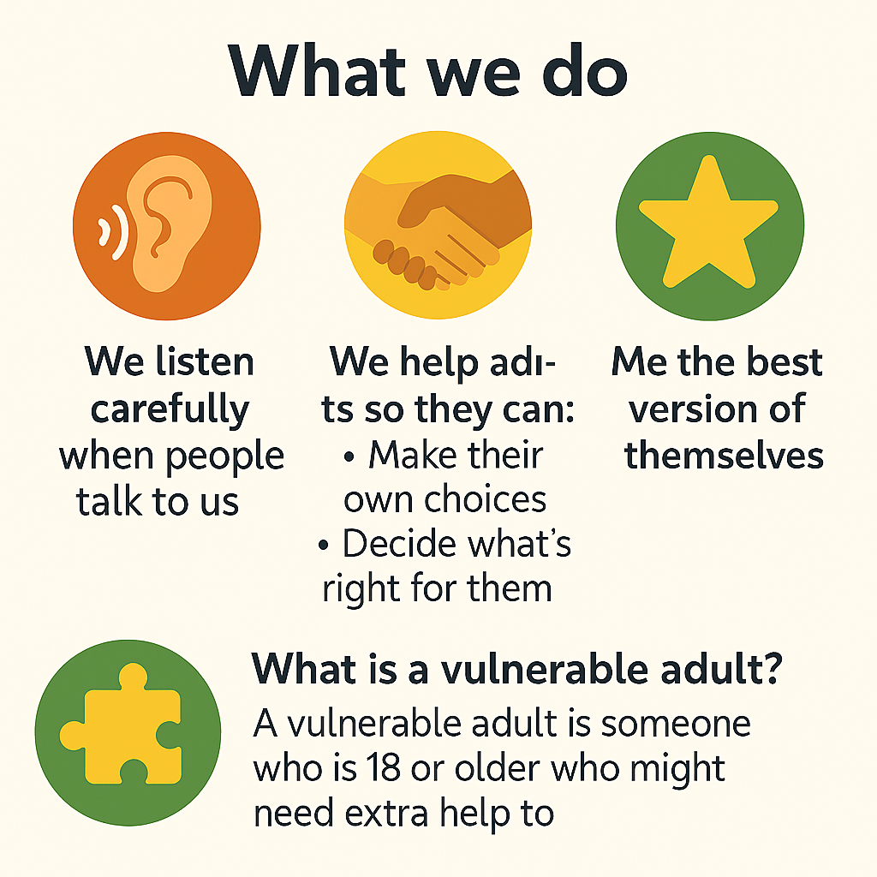
Introduction
This information is to help you to understand how Liverpool Football Club keeps adults safe.
What we do
Listen to you
Support people to make their own choices
Have the best and most enjoyable experience when you access our services

Slide 4
Safe at LFC – what is safeguarding adults?
At Liverpool FC, we want all adults to feel happy, safe, and supported.
Safeguarding means keeping you safe and happy. It’s about making sure you are protected from harm, treated with respect, and have people you can trust and talk to if something worries you. You have the right to feel safe whether you're at home, at work, out with friends, or taking part in anything at LFC. That could be when you’re:
Watching a match
Attending an event at Anfield or a LFC location
Taking part in a LFC Foundation activity
Everyone at LFC has a responsibility to help keep you safe. That means we always put your wellbeing first and will listen if you ever feel worried or unsure about something.
If something doesn’t feel right, it’s always okay to speak up. There are people here who care and want to help.
Definition:
An adult at risk is someone over 18 who has care and support needs, is experiencing or at risk of abuse/neglect, and, because of those needs, cannot protect themselves from harm.

Slide 5

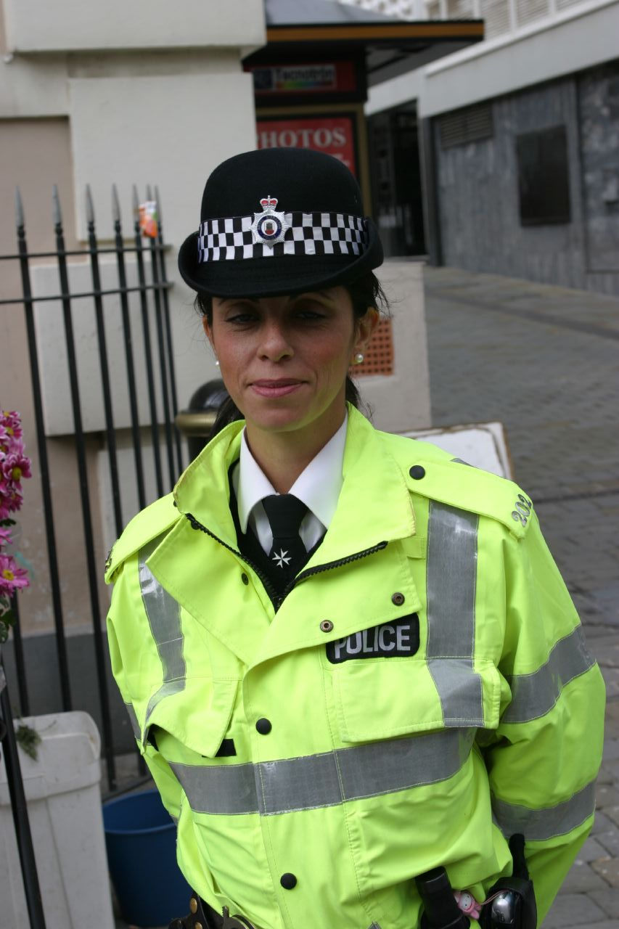
What is abuse
It can happen to anyone, but you can be treated differently (discriminated) because of your;
age,
disability,
gender reassignment,
marriage and civil partnership,
pregnancy and maternity,
race, religion or belief,
sex or sexual orientation
Abuse is when someone does something that can;
hurt you,
upset you
or make you feel frightened or unsafe.
It can happen anywhere;
at home,
at college,
at football,
In the community
or even online.
Anyone could abuse you;
Your family or partner
Work colleagues
Friends at college
A friend
Neighbour
Somebody you trust
Strangers
ABUSE IS A CRIME
If this happens, tell someone you trust straight away. We are here to help keep you safe.

Slide 6
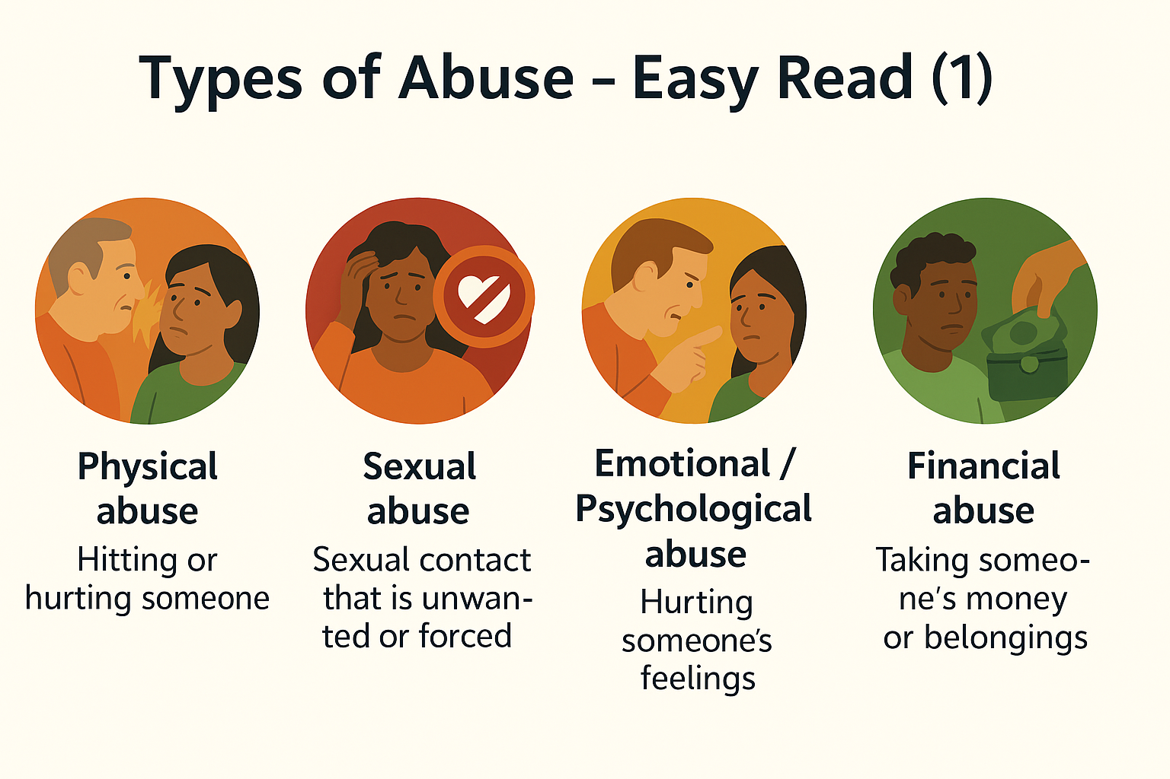
Types of abuse
There are different types of abuse:
Physical Abuse: Hurting someone by hitting, slapping, locking them in a room, or stopping them from moving freely.
Sexual Abuse: Any sexual touching or behaviour that the person does NOT want or did NOT agree to.
Emotional Abuse: Making someone feel scared, controlled, shouted at, made fun of, bullied or lonely.
Financial Abuse: Taking someone's money, stealing things, or tricking them online or in person.
Domestic abuse: Domestic violence is when someone you know, live with, or are in a relationship with: Tries to control you, Threatens you, Hurts you or
Scares you.
Domestic violence can happen to anyone, and it is never your fault.

Slide 7
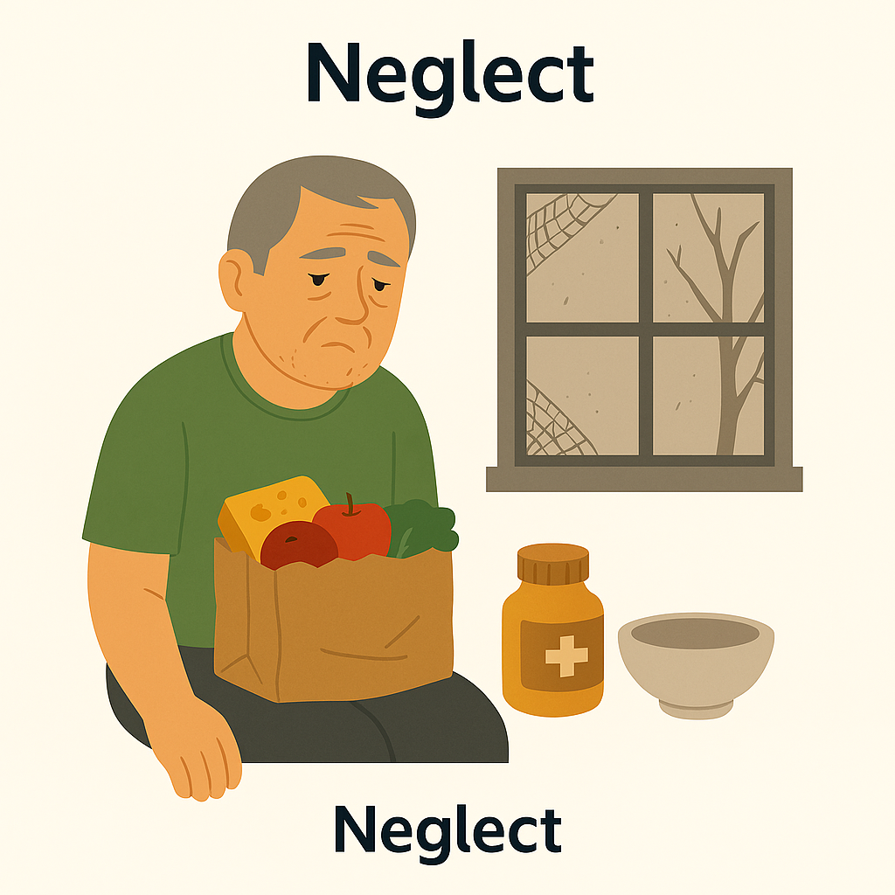



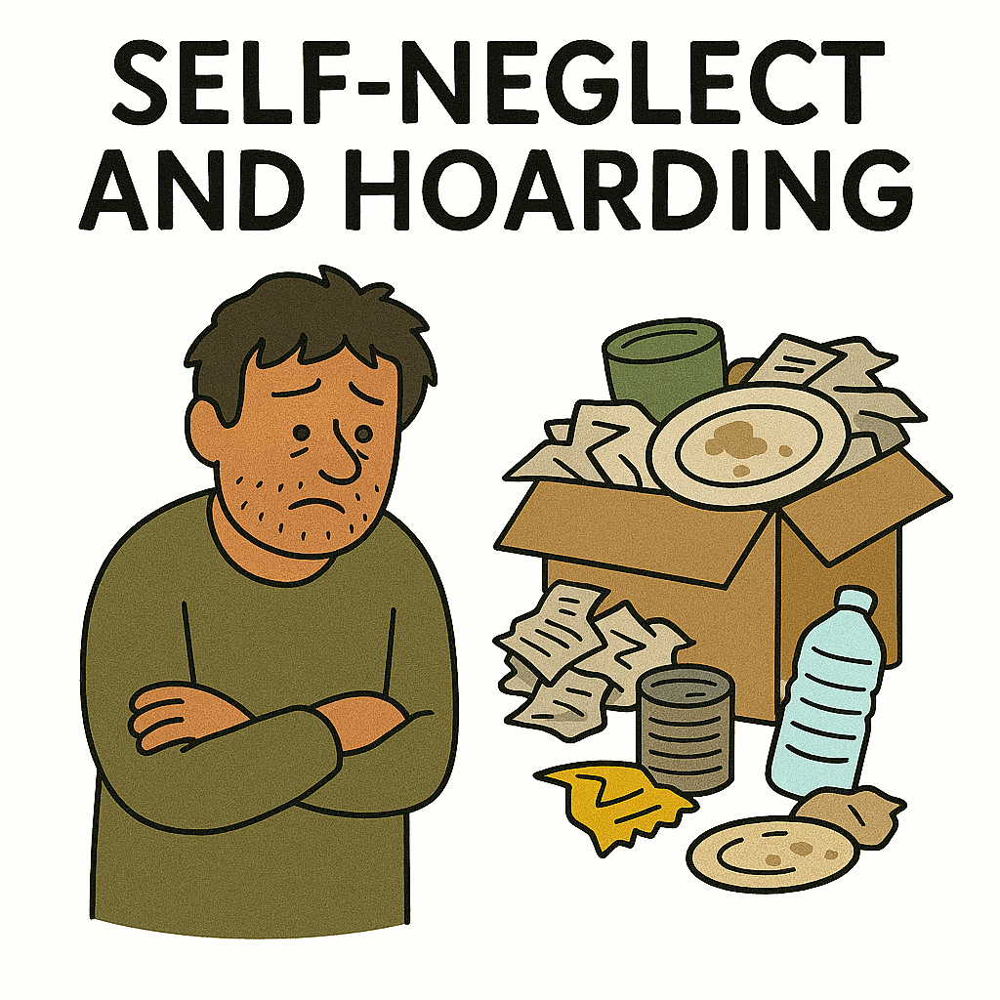
Types of abuse
There are different types of abuse:
Neglect: Not giving someone the care they need such as food, heating, medication or support.
Discrimination: Treating someone badly because of their race, disability, gender, beliefs or who they are.
Organisational Abuse: Bad care in a place like a hospital or care home due to poor rules or staff behaviour.
Modern Slavery: Forcing someone to work, controlling them, or not letting them live freely.
Self-Neglect & Hoarding: When someone cannot look after themselves or collects too many things, making life unsafe.

Slide 8

What to do if you are worried
Telling Someone. It’s Okay
You don’t have to explain everything perfectly. Just say what you can. The most important thing is telling someone.
Who to Tell
Choose an adult you trust, someone who makes you feel safe and listens to you.
You can:
Talk to them
Write it down if that feels easier
They might ask questions to understand better. That’s because they want to help, not because they don’t believe you.
What Happens Next
The adult may need to tell other people to help keep you safe. They should explain who they will tell and why. They cannot keep secrets as they need to try and keep you safe.
You’ll never walk alone

Slide 9


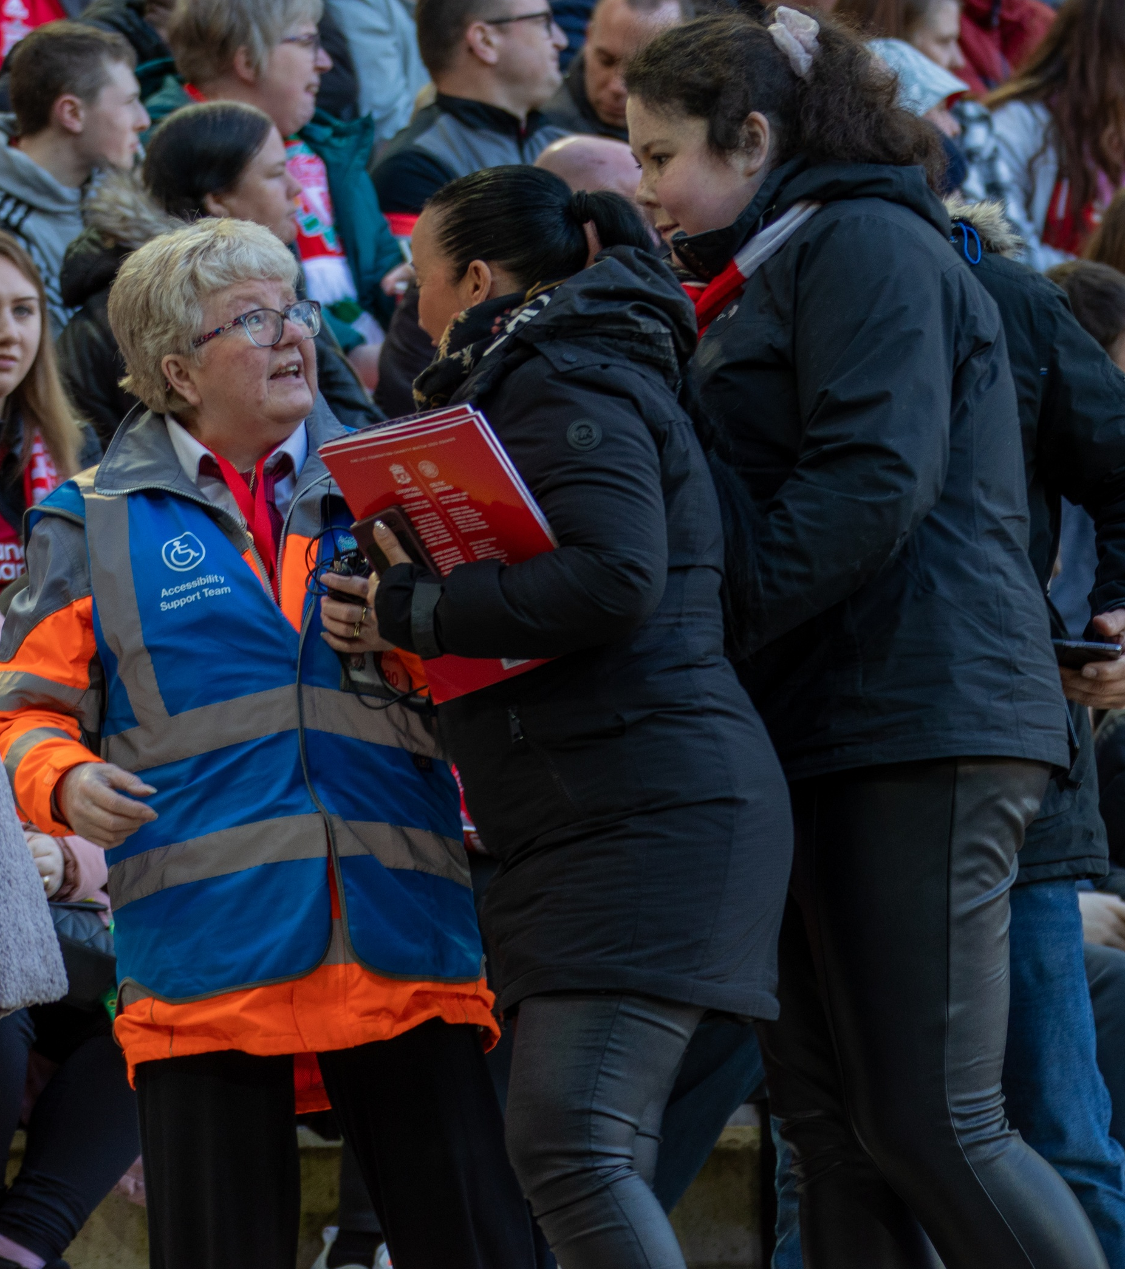
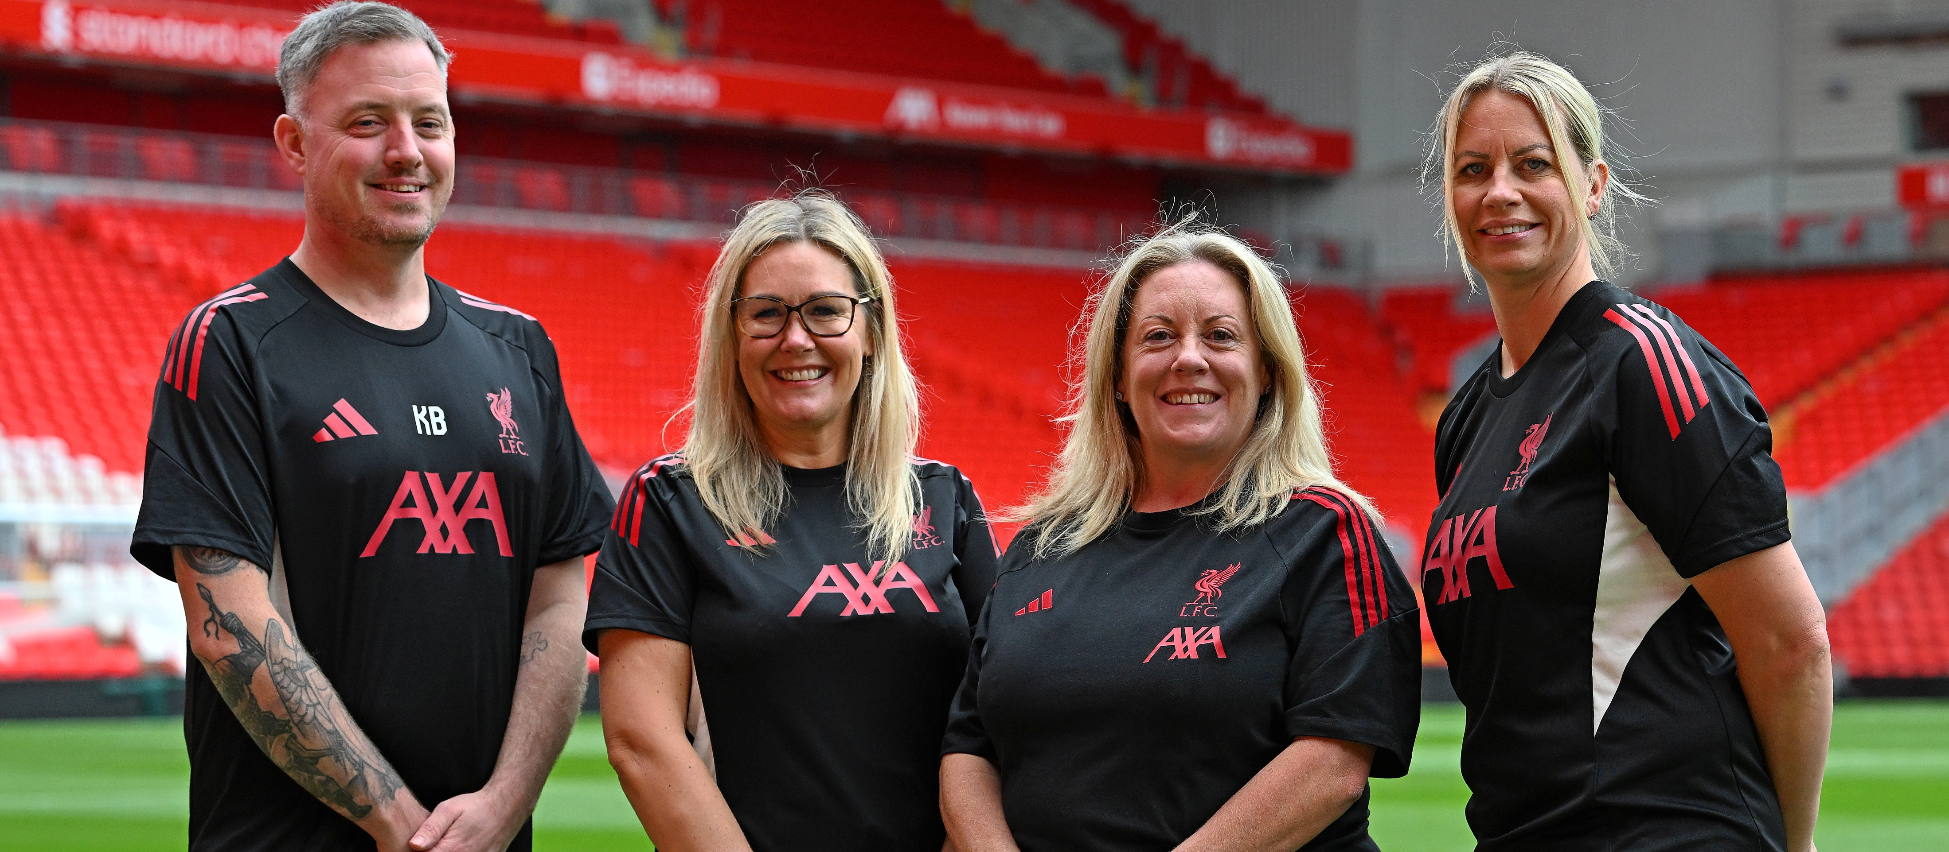

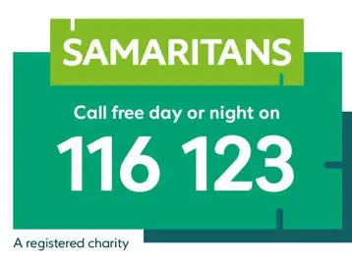
What to do if you are worried
Tell someone you trust (work colleague, family member, social worker, friend)
Speak to a steward, coach or staff member
Contact the LFC Safeguarding Team
Contact Merseyside Police – Telephone 0151 709 6010
Contact the Samaritans – Telephone 116 123
Contact https://www.ceop.police.uk/Safety-Centre/ if you are worried about online communication
You can report a concern anonymously via the website and clicking this link - https://www.liverpoolfc.com/info/report-safeguarding-concern

Slide 10
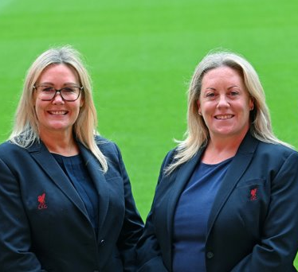
Who to talk to at LFC
We have a dedicated Safeguarding team at Liverpool Football Club who you could reach out to directly.
You will find the LFC Safeguarding team in different areas of the club;
LORNA DUCKWORTH
LFC Deputy Director of Safeguarding
LFC Foundation and
Anfield Designated Safeguarding Lead
NICOLA FRYER
LFC Director of Safeguarding

Slide 11

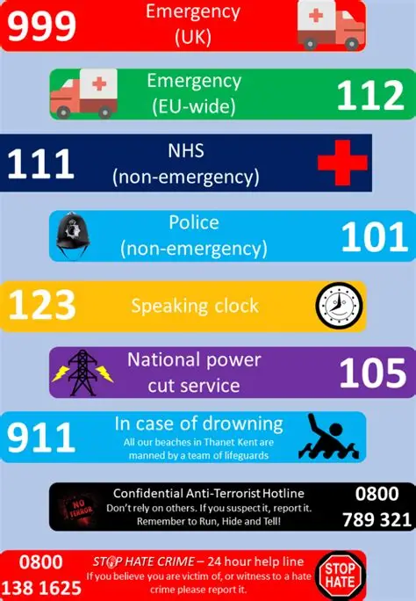
Useful contacts
If concerns relate to the safety of an adult at risk, and you are unable to contact a member of LFC Safeguarding team, please contact the Local Authority :
If you have a concern outside of office hours, or have concerns for the safety of a child, young person or an adult at risk then please contact;
Local Authority | Telephone Number
Knowsley Council | 0151 443 2600
Liverpool City Council | 0151 233 3700
Sefton Council | 0345 140 0845 or 0151 934 3555
Wirral Council | 0151 606 2008 or 0151 677 6557
St Helens Council | 01744 676767
Merseyside Police:
0151 709 6010

Slide 12





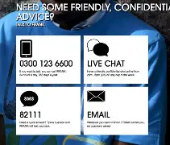


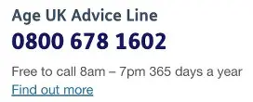
Contact information for people who can help
Hub of Hope national mental health database, bringing help and support together in one place, with a focus on mental health.
Hub of Hope is for everyone and anyone. We all have mental health, so we all need to know the routes to support. The Hub of Hope is not restricted by age or gender.
The hub of hope is available to anybody at hubofhope.co.uk and is a free, downloadable app on iOS and Android devices. Once you have downloaded the app, the user can filter by category of service and postcode.
Tel: 0115 951 5400

Slide 13
Contact information for people who can help
Hub of Hope national mental health database, bringing help and support together in one place, with a focus on mental health.
Hub of Hope is for everyone and anyone. We all have mental health, so we all need to know the routes to support. The Hub of Hope is not restricted by age or gender.
The hub of hope is available to anybody at hubofhope.co.uk and is a free, downloadable app on iOS and Android devices. Once you have downloaded the app, the user can filter by category of service and postcode.
Tel: 0115 951 5400

