Slide 1
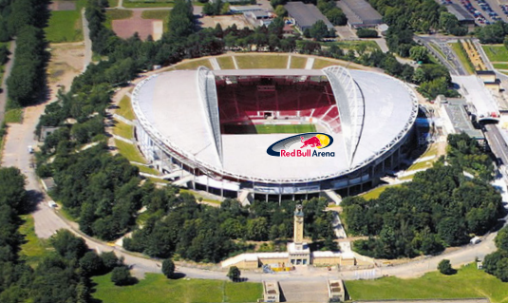
FAN INFORMATION
Planning your Visit
Leipzig v Liverpool FC KO 21:00 Local Time Wednesday 23rd October 2024
Liverpool Football Club appreciates the dedication and loyalty of
our travelling fans. Below is general advice and information which you may find helpful when planning your trip.
Important Information
Address Address:
RED BULL ARENA
Am Sportforum 7 04105 Leipzig This address will take you to the visitors end of the stadium
"Am Sportforum 3, 04105 Leipzi This is the South entrance for wheelchair users and ambulant disabled supporters.
100% ticket collection will take place for this fixture.
Kick-off is 21:00 local time. Germany is 1 hour ahead of United Kingdom
Turnstiles will open at 19:00 local time (2 hours before kick-off)
Phone chargers are not permitted inside the stadium. They can be stored at the storage area outside the stadium and collected post-match.
Bag Policy – A4 size will be permitted into the stadium. There is a drop-off point for prohibited items although there is limited space available.
The stadium kiosks are cashless.
Fans are urged to arrive early at the stadium. There will be an enhanced searching in operation including ticket check points at the stadium and body searches (pat-downs) will be conducted.
Flags/Banners – all banners would require to be pre-approved by the Leipzig operation ahead of the game. For supporters wishing to bring a banner, please ensure a picture of the banner, size and fire safety certification is emailed to slo@liverpoolfc.com by Friday, 18th October 2024.
Supporters without tickets are urged not to travel to the game as the match is a sell-out.

Slide 2
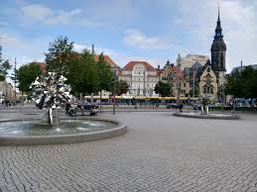
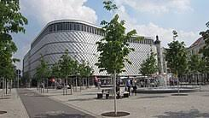
Drop off pre match: 500m from shuttle bus stop to away entrance
Leipzig main station (700m from Richard-Wagner-Platz)
Leipzig main station (700m from Richard-Wagner-Platz)
Leipzig main station (700m from Richard-Wagner-Platz)
FAN INFORMATION
Matchday
Important Matchday
Information
Fan Meeting Point
Supporters are advised by the Police to congregate in the Richard Wagner Platz area.
This is a tourist area directly next to a large shopping centre and is packed with bars and restaurants.
The matchday shuttle buses pick up is from this square and will drop you off 500m from the visitor's section.
Post match the shuttle will be ready where supporters were dropped off. The shuttle will drop supporters back at Leipzig’s main station (700m from Richard-Wagner-Platz) This location and it is also next to the tram stop and the central rail station is close by.
10 x shuttle buses will be provided by RB Leipzig to and from the city centre pre and post-match at Richard Wagner Platz near to the central station in the city centre. First shuttle will leave from 18:15. This is the recommended mode of transport.
THE SHUTTLE BUSSES ARE NOT WHEELCHAIR ACCESSIBLE.

Slide 3
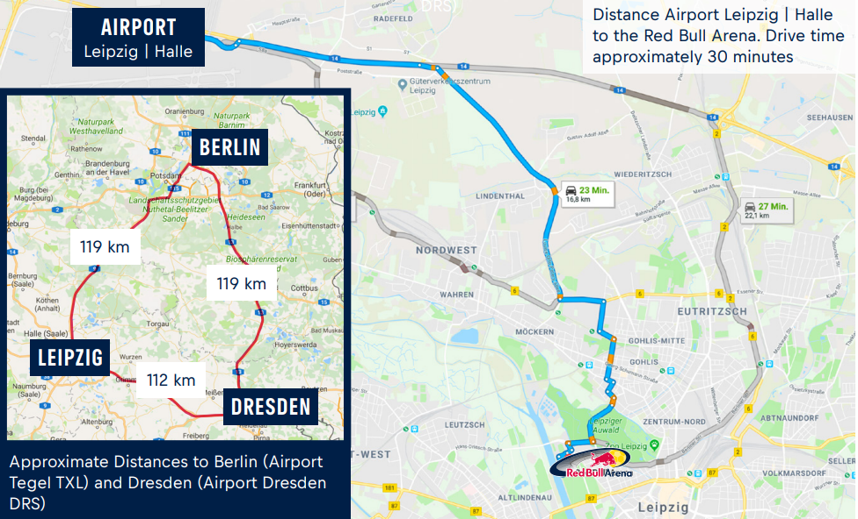
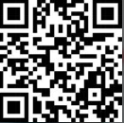
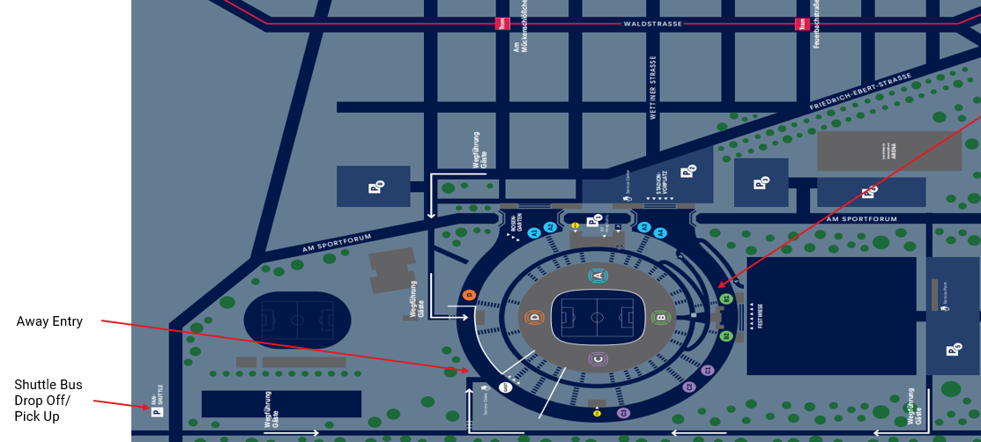
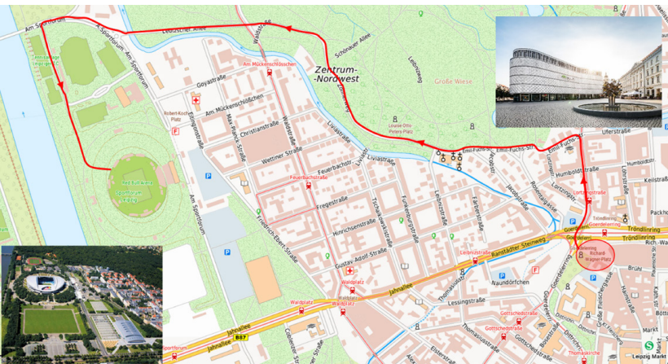
FAN INFORMATION
Planning your Visit
Important Information
Getting to the stadium:
Public Transport
Public transport is free with a match ticket. It can be used five hours before and after the game in the area of the MDV (Central German Public Transit Network)
The nearest stop of public transport is not immediately at the visiting end and as such would require a lengthy walk.
To support LFC fans, Leipzig has arranged shuttle buses. These buses will depart from the recommended meeting point at "Richard-Wagner-Platz" (Richard-Wagner-Platz, 04109 Leipzig, just 700 meters from Leipzig main station) or from Leipzig main station and drop supporters off near the guest entrance. From there, it's an additional 500 meters on foot to the entrance.
Tram –
If you use tram station "Sportforum Süd" or "Sportforum Ost" you must follow the path along the river. They are marked with white arrows and named "Wegführung Gäste.
You can only use the entrance "GAST" (guest).
Tickets for "GAST" cannot be used to enter the home areas
(Festwiese, Rosengarten, Stadionvorplatz
As part of the match ticket public transportation can be used
four hours before and after the game in the area of the MDV
(Central German Public Transit Network)

Slide 4
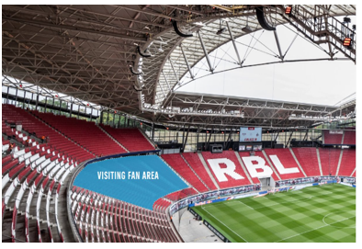
FAN INFORMATION
Matchday
Important Matchday
Information
At the stadium:
Kick-off is at 21:00hrs local time (20:00hrs GMT).
Turnstiles will open at 19:00 CET (two hours before kick-off). Germany is one hour ahead of the UK (+1 BST).
Liverpool FC supporters will enter the stadium via the north-west corner of the stadium between C and D. There will be LFC Stewards at this point to direct the route into the turnstiles.
Fans do not have to be in possession of photographic ID BUT it is recommended as whilst there is no overriding requirement for entry purposes there may be individual checks.
Please be aware that there will be ticket check points on the approach to the turnstiles then body (pat-downs) and bag searches once inside.
Supporters without tickets are therefore urged not to travel to the game as the match is a sell-out

Slide 5
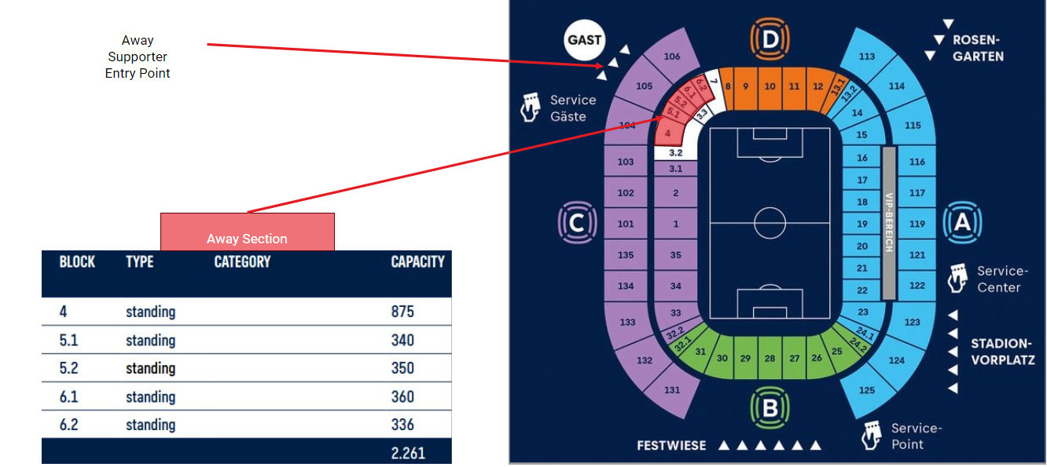
FAN INFORMATION
Matchday
Important Matchday
Information
At the stadium:
There are good welfare and refreshment facilities on the concourse and the stadium is cashless only.
Alcohol will be served to visiting fans and can be taken on to the terracing
There are male and female toilets located close to the seating.
The visiting supporters’ area is enclosed by a two-metres high robust radial glass screen at the front, which may cause some obstruction with a view of the pitch for those supporter’s allocated railed seating at the lower elevation of the sector.
The stadium is built within the bowl of the original stadium and therefore as shown in the photographs there are steps leading up to an exterior concourse from the turnstiles and then down to internal concourse with no lifts available.

Slide 6
FAN INFORMATION
Matchday
Accessibility seating and facilities
Important Matchday Information
The entrance gate for LFC wheelchair users is located at the main entrance on the home side ("Am Sportforum 3, 04105 Leipzig"). There is a dedicated team at the stadium for this section. LFC accessibility stewards will also be on hand to support.
The shuttle bus service provided from Richard Wagner Platz pre match and main station post match is not wheelchair accessible.
Leipzig colleagues Mandy, Birgit (SLO/DAO) and her team "Inklusion" will be on main entrance (Sportforum 3) to support all disabled supporters. The LFC accessibility team and DLO will also be available.
If you are traveling by car, we can help you with a parking space. Capacity is limited so please email slo@liverpoolfc.com If you need one.
Trams are available to the stadium from the city centre to Sportforum Ost station and these are also wheelchair friendly. This station is 700m from the wheelchair entry point.
The third option is by car or taxi which can drop very close to the wheelchair access point.
The public transport system is accessible for wheelchair users and further information can be found on the following link https://www.l.de/en/mobility/people-with-disabilities/
The wheelchair platform is serviced by a lift and is situated directly next to the away supporter section in the home section, but we are reassured that this is in a safe area.
Dedicated RB Leipzig stewards will escort supporters to the wheelchair bays supported by LFC accessibility stewards.
Disabled toilets were clean and close to wheelchair bays
Refreshment kiosk is not at an accessible height for wheelchair users, however RBL stewards will assist where required.

Slide 7
FAN INFORMATION
Useful contact information
Emergency Numbers
UK Embassy
Emergency services in Germany
If you need to contact the emergency services, call these numbers:
Ambulance: 112
Fire: 112
Police: 110
You can also download the 112 Where Are U app, the official European emergency
number app. It is only available in some parts of Germany.
British Consulate Germany (no UK Embassy in Leipzig)
Wilhelmstraße 70/71
10117 Berlin
Germany
To call 24/7 in an emergency or send us an online enquiry go to: https://www.contact.service.csd.fcdo.gov.uk/posts/germany/british-embassy-berlin
Information from Merseyside Police:
A team of Merseyside Police Officers will be operationally deployed overseas. The officers are there at the invitation of the German Police and have no powers whilst deployed. The primary function of the team is to advise the local Police service and gather and disseminate information.
If you have any issues whilst you are at this match that you feel need bringing to the attention of the delegation, please email 8070@merseyside.police.uk Lee Lomax (Football Officer). Constable Lomax has access to his e-mails.
Supporter Liaison Officer (SLO/DLO)
To assist those supporters who are attending away matches both domestically and overseas. A dedicated fan support telephone number and email address is available for travelling fans attending away fixtures (this line of communication is for urgent matters relating to the game only).
This line / email will be made available two hours before kick-off and will be open until one hour after final whistle. The telephone number is 0151 3181040 (From abroad +44 151 318 1040) and the email address is slo@liverpoolfc.com
Our SLO will be in attendance along-side a team of stewards and an accessible team at the stadium
On behalf of the Club, we hope you have a safe and enjoyable trip to Germany
YNWA

